Slide 1

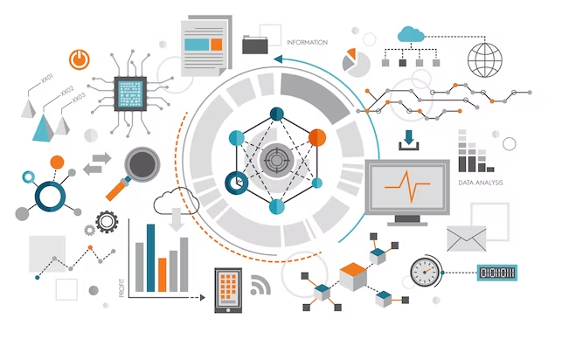
UNIT 1
Introduction to Data Science

Slide 2
Contents
Unit 1
Basics and need of Data Science
Data
Methods
Applications of Data Science
Data Types
Data Cleaning
Relationship between Data Science and Information Science
Data Integration
Data Collection
Data Reduction
Business intelligence versus Data Science
Need of Data wrangling
Data Transformation &
Data Discretization

Slide 3

Course Outcome
Unit 1
CO1: Analyze needs and challenges for Data Science

Slide 4
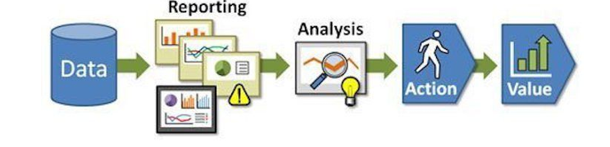
Basics
Unit 1
Data Analysis
Data analysis is a procedure of investigating, cleaning, transforming, and training of the data with the aim of finding some useful information, recommend conclusions and helps in decision-making

Slide 5
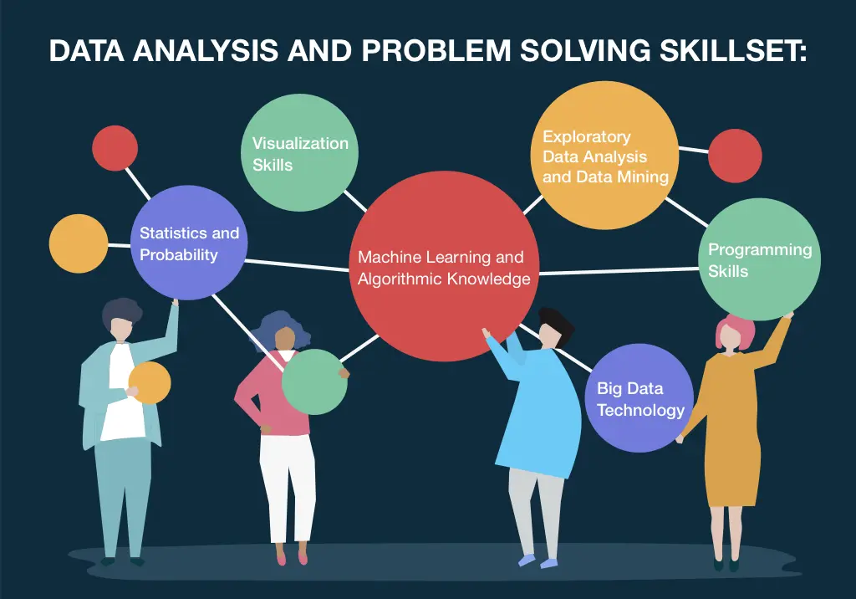
Basics
Unit 1
Data Analytics
Analytics is utilizing data, machine learning, statistical analysis and computer-based models to get better insight and make better decisions from the data.

Slide 6
Example Of Data Analysis
Unit 1
Scenario: An e-commerce company wants to understand customer purchasing behavior to improve sales and marketing strategies.
Steps in Data Analysis:
1. Data Collection:
The company gathers data from various sources, such as:
Sales transactions (product, price, date, customer ID).
Customer demographics (age, gender, location).
Website analytics (time spent on site, pages visited).
Marketing campaigns (email open rates, click-through rates).
2. Data Cleaning:
Remove duplicate entries.
Handle missing values by imputing or removing incomplete records.
Standardize data formats (e.g., date formats).

Slide 7
Basics
Unit 1
3. Data Exploration:
Descriptive Statistics: Calculate mean, median, mode, variance, etc., to understand data distribution.
Visualizations: Use charts (e.g., bar charts, histograms, scatter plots) to identify patterns and trends.
Example Findings:
A majority of customers are between 25-34 years old.
Sales peak during weekends.
Certain products sell better in specific regions.
4. Data Analysis:
Segment Customers: Group customers based on purchasing behavior (e.g., frequent buyers, occasional buyers).
Correlation Analysis: Check if there's a relationship between variables, such as marketing emails and sales.
Trend Analysis: Identify sales trends over time.

Slide 8
Basics
Unit 1
Example Insights:
Customers from urban areas tend to buy higher-value items.
Email campaigns sent on weekdays have a higher open rate.
Products with more detailed descriptions have higher sales.
5. Interpretation and Decision-Making:
Based on the analysis, the company might decide to:
Target marketing campaigns to the 25-34 age group.
Increase promotions during weekends.
Improve product descriptions to boost sales.
Outcome:
By analyzing the data, the company gains actionable insights, leading to better-targeted marketing strategies, optimized inventory management, and ultimately increased sales and customer satisfaction.

Slide 9
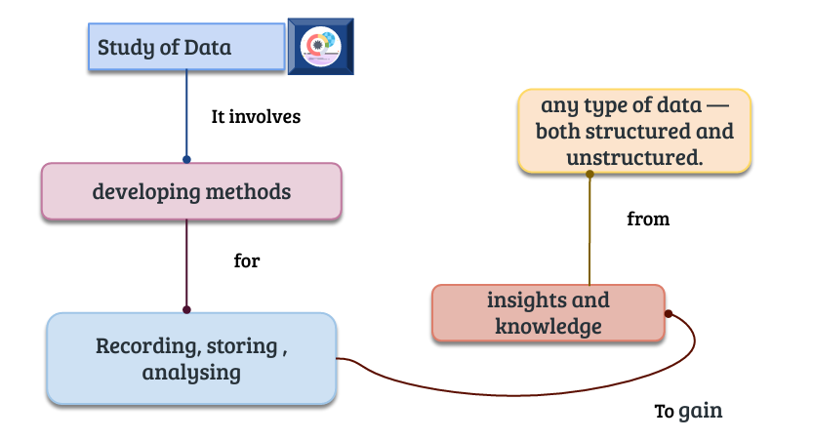
Basics
Unit 1
Data Science

Slide 10
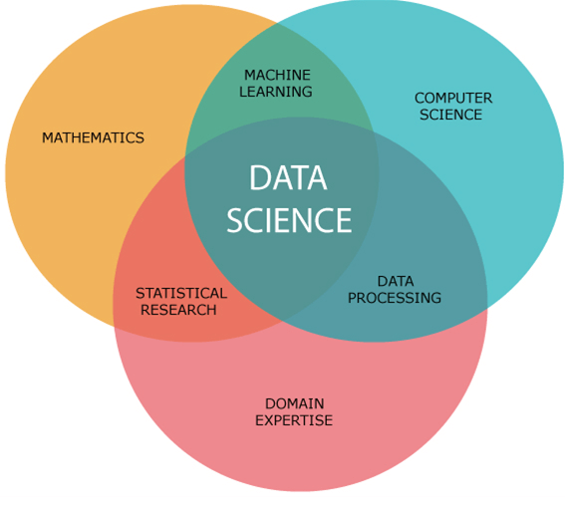
Basics of Data Science
Unit 1
Data Science is an interdisciplinary
field that combines techniques
from statistics, computer science,
and domain expertise to extract
insights and knowledge from data.
It involves various processes,
algorithms, and systems to
analyze large volumes of structured
and unstructured data, enabling
informed decision-making.

Slide 11
Basics of Data Science
Unit 1
https://www.youtube.com/watch?v=xC-c7E5PK0Y

Slide 12
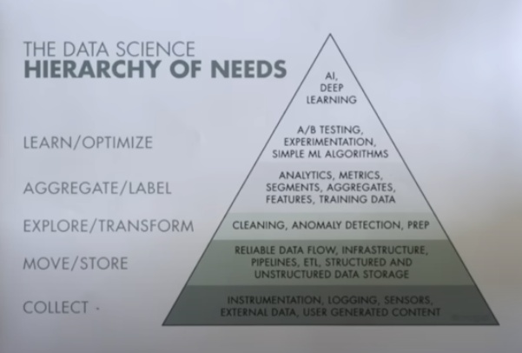
Basics of Data Science
Unit 1

Slide 13
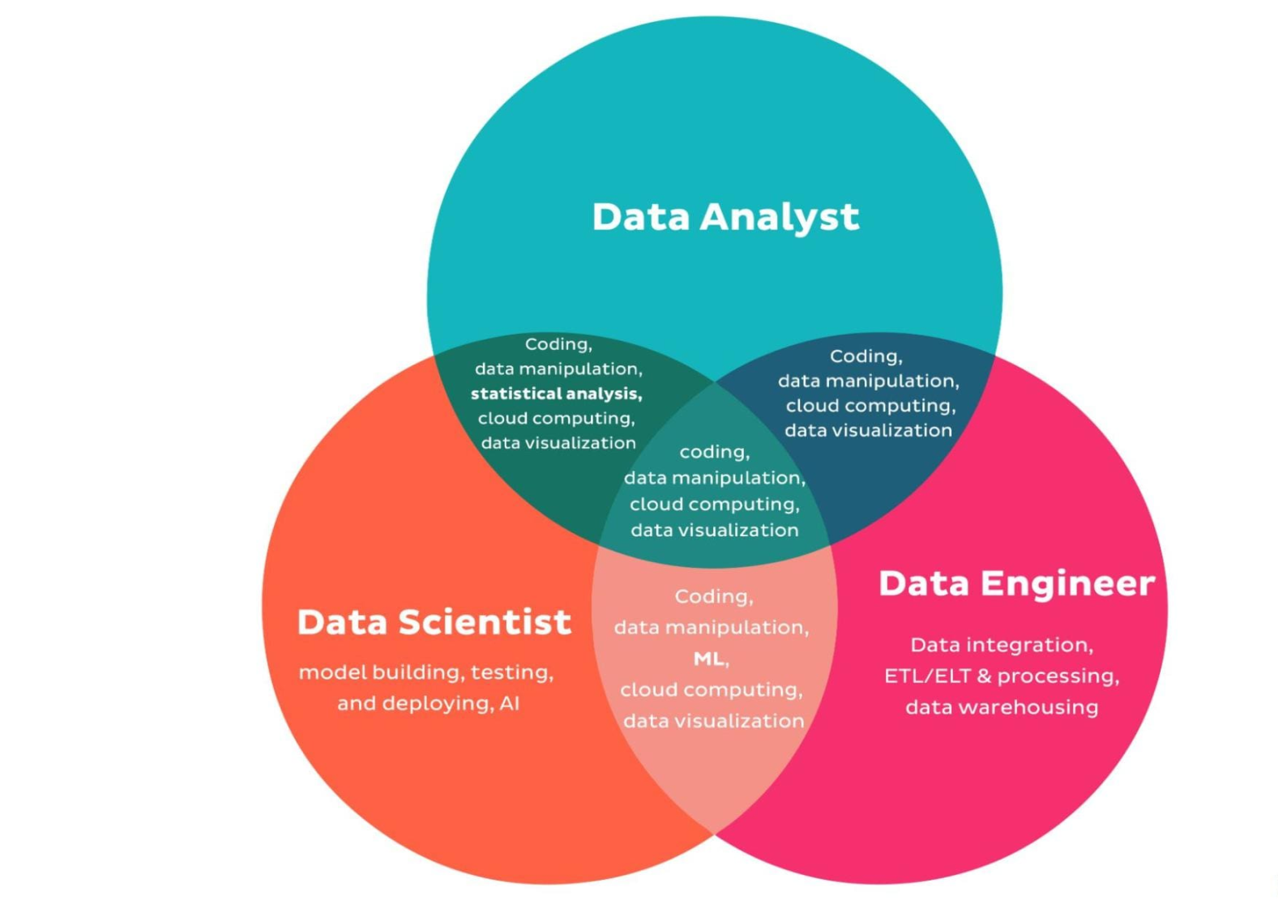
Basics of Data Science
Unit 1
Summary:
Data Analyst: Insight-focused, interprets data, and creates visualizations.
Data Scientist: Builds and deploys advanced predictive models.
Data Engineer: Constructs and optimizes
data systems and pipelines.
All Three Roles:
Share skills in coding, data
manipulation, cloud computing,
and data visualization. These are
essential skills for working with data
at any level.

Slide 14
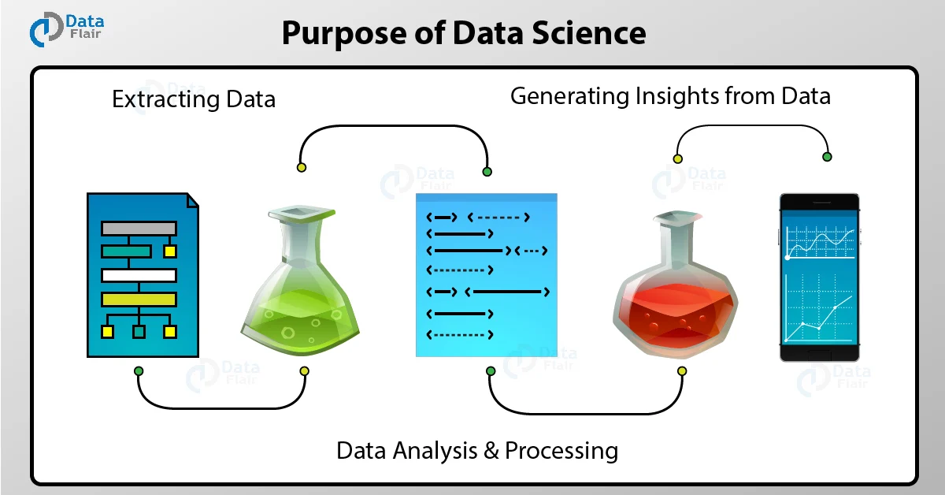
Basics of Data Science
Unit 1

Slide 15
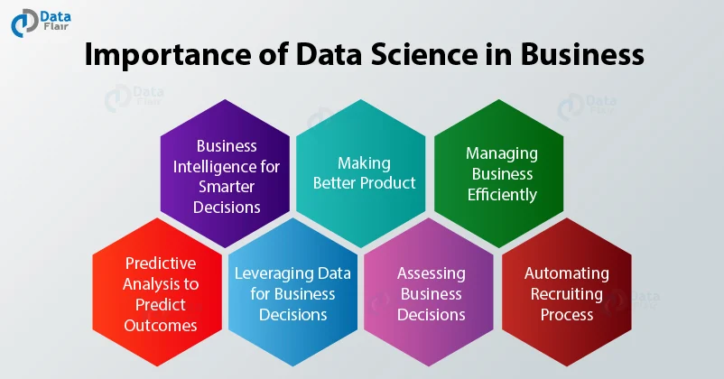
Basics of Data Science
Unit 1

Slide 16
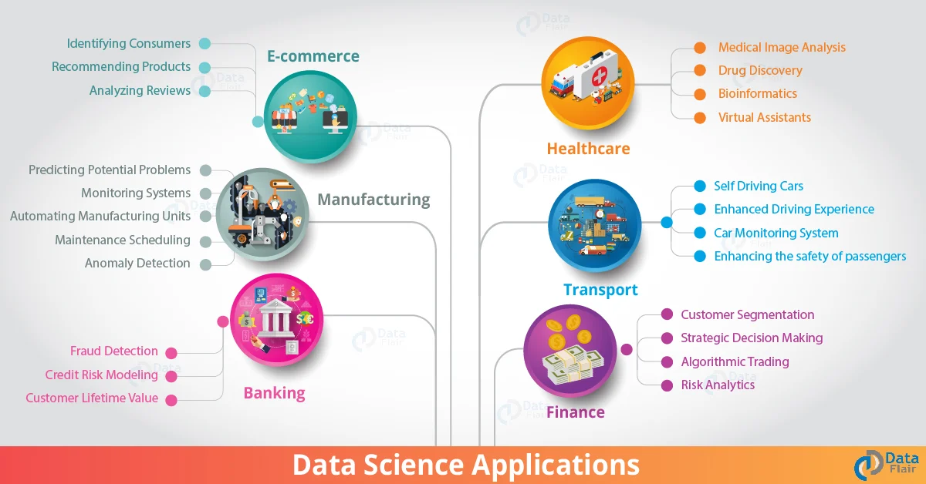
Applications of Data Science
Unit 1

Slide 17
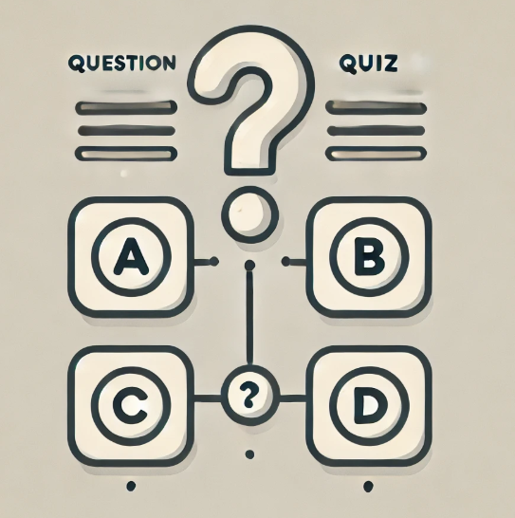
Quiz
Unit 1

Slide 18
Relationship between Data Science and Information Science
Unit 1
Data science and information science are related fields that share common elements, but they also have distinct focuses and goals.
Data Science | Information Science
Data science is an interdisciplinary field that involves the extraction of insights and knowledge from structured and unstructured data. It incorporates techniques from statistics, mathematics, and computer science to analyze and interpret complex data sets. | Information science, on the other hand, is a broader field that deals with the study of information and its properties. It encompasses the organization, retrieval, storage, and wide spreading of information.

Slide 19
Relationship between Data Science and Information Science
Unit 1
Data vs. Information
Data Science | Information Science
It involves data analysis, machine learning, and statistical modeling to draw conclusions from data. | It looks at how information is processed and utilized in various contexts.

Slide 20
Relationship between Data Science and Information Science
Unit 1
Methods and Techniques:
Data Science | Information Science
relies on statistical methods, machine learning algorithms, data visualization, and programming | database management, information retrieval, knowledge representation, and information systems design.

Slide 21
Relationship between Data Science and Information Science
Unit 1
Applications:
Data Science | Information Science
Applications in various industries, including finance, healthcare, marketing, and technology, to make data-driven decisions, build predictive models, and uncover hidden patterns in data. | information management, knowledge organization. It deals with the systematic organization and retrieval of information to support decision-making and knowledge dissemination.

Slide 22
Relationship between Data Science and Information Science
Unit 1
Applications:
Summary
Data science and information science are related fields, but they approach the handling of data and information from different perspectives. Data science is more focused on extracting insights and patterns from data, while information science is concerned with the broader aspects of information management and organization.

Slide 23
Business intelligence versus Data Science
Unit 1
https://www.youtube.com/watch?v=wjILmMxantI

Slide 24
Business intelligence versus Data Science
Unit 1
Definition:
Business Intelligence | Data Science
BI is a set of technologies, processes, and tools that help organizations collect, analyze, and present business data to support decision-making. It often involves reporting, querying, dashboards, and data visualization to provide insights into historical and current business performance. | Data Science is a broader field that encompasses various techniques and methods to extract insights, knowledge, and predictions from data. It involves statistical analysis, machine learning, data modeling, and programming to uncover patterns and trends in both historical and real-time data.

Slide 25
Business intelligence versus Data Science
Unit 1
Focus:
Business Intelligence | Data Science
BI primarily focuses on reporting and analysis of past and current business performance. It is often used for monitoring key performance indicators (KPIs), generating reports, and providing historical context to aid in decision-making. | focuses on extracting insights and making predictions from data. It involves exploring data to identify patterns, building predictive models, and deriving actionable insights to support strategic decision-making.

Slide 26
Business intelligence versus Data Science
Unit 1
Scope :
Business Intelligence | Data Science
BI typically deals with structured data and is well-suited for reporting and analysis of structured data sets. It provides a clear and concise view of historical and current business operations. | handle both structured and unstructured data. It includes more advanced analytics, such as machine learning, to predict future trends and behaviors based on historical data.

Slide 27
Business intelligence versus Data Science
Unit 1
Decision-making :
Business Intelligence | Data Science
decision-making by providing structured and predefined reports. It helps organizations understand what has happened and why. | decision-making by providing deeper insights, identifying patterns, and making predictions. It often involves exploring data to discover new opportunities or risks.

Slide 28
Business intelligence versus Data Science
Unit 1
Tools and Technologies :
Business Intelligence | Data Science
Tableau, Power BI, and Qlik, which focus on data visualization, reporting, and dashboard creation. These tools are designed for ease of use and accessibility by business users | include programming languages like Python and R, as well as frameworks such as TensorFlow and scikit-learn. These tools are more geared toward data scientists

Slide 29
Business intelligence versus Data Science
Unit 1
Time Horizon:
Business Intelligence | Data Science
deals with historical and current data, providing a snapshot of what has happened and what is currently happening | involve both historical and real-time data analysis, and it often includes predictive modeling to forecast future trends.

Slide 30
Business intelligence versus Data Science
Unit 1
Business Intelligence (BI) Example:
Scenario: A retail company wants to analyze its past sales performance.
Process:
Data Collection: The company collects historical sales data from its database.
Data Visualization: Using BI tools like Tableau or Power BI, the company creates dashboards and reports.
Insights: The dashboards show trends such as which products sold the most in the last quarter, regional sales performance, and peak sales periods.
Outcome: The company uses these insights to make informed decisions about inventory management, marketing strategies, and sales forecasts.
2. Data Science Example:
Scenario: The same retail company wants to predict future sales and understand factors driving customer purchases.
Process:
Data Collection: The company gathers historical sales data, customer demographics, weather data, and online search trends.

Slide 31
Business intelligence versus Data Science
Unit 1
Data Cleaning: Ensures data accuracy and consistency.
Model Building: Data scientists apply machine learning algorithms to build a predictive model.
Prediction: The model forecasts future sales and identifies key factors influencing customer behavior.
Outcome: The company can predict future sales trends, optimize stock levels, personalize marketing campaigns, and enhance customer satisfaction.
Key Differences:
BI focuses on descriptive analytics, providing insights based on historical data to inform current business operations.
Data Science uses predictive analytics and machine learning to forecast future trends and identify patterns in data for strategic planning.

Slide 32
Data
Unit 1
Definition:
Data
raw facts, figures, symbols, or raw information that can be processed and converted into meaningful insights

Slide 33
Data
Unit 1
Sources of Data: :
Human-generated Data
Textual Data: This includes documents, articles, emails, social media posts, and any other written content. Numeric Data: Data entered manually, such as survey responses, financial transactions, or any form of numerical input.

Slide 34
Data Types
Unit 1
Data types refer to the classification of data based on the kind of values they can hold. There are several main categories of data types:
a) Primitive Data Types:
These are the most basic types of data that a programming language understands natively.
Integer (int): Whole numbers without a decimal point (e.g., -5, 42).
Float (float): Numbers that can have a decimal point (e.g., 3.14, -0.01).
Character (char): A single character, like 'A', 'b', '3'.
Boolean (bool): Data that represents truth values, typically True or False.
String (str): A sequence of characters (e.g., "Hello, World!").

Slide 35
Data Types
Unit 1
b) Composite Data Types:
These data types are made up of multiple primitive data types.
Array/ List: A collection of elements, often of the same type (e.g., [1, 2, 3, 4]).
Tuple: An ordered collection of elements that may be of different types and are immutable (e.g., (1, "apple", True)).
Dictionary (dict): A collection of key-value pairs (e.g., {"name": "Alice", "age": 30}).
Set: A collection of unique items (e.g., {1, 2, 3}).
c) Complex Data Types:
These involve more sophisticated data structures.
DataFrame (in Python with Pandas): A two-dimensional labeled data structure that can hold data of various types (e.g., tables in a spreadsheet).
Graph: A collection of nodes (vertices) and edges (connections) representing relationships between data points.
Tree: A hierarchical data structure where each node has a parent and zero or more children, often used in organizational charts or file systems.

Slide 36
Data Collection
Unit 1
Data collection refers to the process of gathering raw data from various sources for analysis. The methods of collection vary depending on the type of data, the research question, and the field of study. Below are common methods of data collection:
a) Quantitative Data Collection:
This involves gathering numerical data that can be measured and analyzed statistically.
Surveys/Questionnaires: A structured way to gather data from respondents. Surveys typically consist of closed-ended questions (e.g., yes/no, multiple choice).
Experiments: Collecting data through controlled experiments to observe the effects of variables.
Sensors/Devices: Using physical devices to collect data automatically, such as temperature sensors or motion detectors.
Web Scraping: Extracting data from websites using automated scripts.

Slide 37
Data Collection
Unit 1
b). Qualitative Data Collection:
This involves gathering non-numerical data that is more descriptive in nature.
Interviews: In-depth conversations with individuals to gather insights, often used in social sciences or market research.
Focus Groups: Group discussions aimed at exploring participants' opinions and experiences.
Observations: Collecting data by watching people, events, or behaviors in a natural or controlled environment.
Textual Analysis: Analyzing documents, social media, or other textual sources to gather insights or categorize information.
c). Mixed Methods Data Collection:
Combining both quantitative and qualitative data collection methods to offer a more comprehensive analysis. For example, a survey with both closed and open-ended questions.

Slide 38
Data Collection
Unit 1
Aspect | Qualitative Example | Quantitative Example
AI Product Feedback | "What do you like about this AI app?" | "Rate the app's user-friendliness (1–10)."
User Interaction | Observing users’ emotional reactions during an AI demo. | Recording the time users spend on the platform.
Health Study | Documenting patient stories about treatment experiences. | Measuring the recovery rate after using AI tools.

Slide 39
Data Collection
Unit 1
d) Secondary Data Collection:
Using data that was collected for other purposes but can be repurposed for a new study. Examples include government statistics, public reports, and data from academic research.
e) Data Mining and APIs:
Data Mining: A technique used to find patterns in large datasets, often involving algorithms or machine learning.
APIs (Application Programming Interfaces): Collecting data from external sources by interfacing with systems or platforms (e.g., social media APIs, financial data APIs).

Slide 40
Data Collection Challenges
Unit 1
Data Quality: Ensuring that the collected data is accurate, consistent, and free from errors.
Data Privacy: Protecting the privacy and confidentiality of sensitive data, especially when collecting personal information.
Data Bias: Avoiding bias in data collection methods to ensure that the results are representative. Ex: A well-known real-world case of algorithmic bias occurred with Amazon's hiring algorithm. The system was designed to help Amazon review resumes, but it was found to be biased against female candidates. This bias arose because the algorithm was trained on resumes submitted to Amazon over the previous decade, and because the tech industry has been male-dominated, the system learned to favor male-associated keywords and job titles. As a result, it downranked resumes that used female-associated terms or indicated female job titles.
Volume: Managing large amounts of data, especially in fields like big data, IoT (Internet of Things), and social media analytics.

Slide 41
Data Wrangling
Unit 1
Data wrangling (also known as data cleaning or data preprocessing) is the process of transforming and mapping raw data into a more usable format for analysis. It involves cleaning, restructuring, and enriching data to ensure that it is accurate, consistent, and in a format that can be used effectively by data analysts, data scientists, or machine learning models.

Slide 42
Steps Involved in Data Wrangling
Unit 1
Data Collection: Gathering data from different sources (databases, spreadsheets, web scraping, APIs, etc.).
2. Data Cleaning:
a. Handling Missing Data: Filling in missing values, removing incomplete data, or replacing missing values with a default value or mean.
b. Removing Duplicates: Identifying and removing duplicate records to ensure
the dataset doesn't have redundant information.
c. Fixing Inconsistent Data: Correcting data that may have inconsistent
formatting, such as dates stored in different formats, or values entered incorrectly.
d. Handling Outliers: Identifying and addressing data points that are
significantly different from others (outliers) if they could skew analysis results.

Slide 43
Steps Involved in Data Wrangling
Unit 1
3. Data Transformation:
a. Normalization/Standardization: Adjusting the range of numeric values in the dataset to a common scale (e.g., scaling all values between 0 and 1).
b. Encoding Categorical Variables: Converting categorical variables (like "red", "green", "blue") into numeric format, which can be used in machine learning algorithms.
c. Aggregation: Combining data points into a more useful summary, such as calculating averages, totals, or grouping by categories.
d. Feature Engineering: Creating new features or variables from existing ones to help improve analysis or model performance (e.g., extracting year, month, and day from a timestamp).

Slide 44
Steps Involved in Data Wrangling
Unit 1
4. Data Integration: Merging data from multiple sources or tables to form a complete and cohesive dataset.
5. Data Reduction: Reducing the volume of data by eliminating unnecessary or irrelevant columns or rows.
6. Data Validation: Ensuring that the data conforms to required standards and business rules (e.g., age values must be positive integers).

Slide 45
Need For Data Wrangling
Unit 1
Data wrangling is essential because real-world data is often messy, unstructured, and incomplete. It is rare to find perfectly clean and ready-to-analyze datasets, especially in big data and complex scenarios. Here's why data wrangling is crucial:
1. Improves Data Quality:
a. Raw data often contains errors, inconsistencies, or missing values. Data wrangling helps clean and correct these issues to improve the quality of data and make it reliable for analysis.
b. Handling missing values, duplicates, and inconsistent formats ensures that you have clean data for accurate analysis or model training.
2, Enables Better Analysis:
a. Unclean data can lead to incorrect conclusions or misleading results. By transforming the data into a format suitable for analysis, wrangling ensures that the analysis is based on accurate and relevant data.
b. It allows analysts to identify patterns, trends, and insights more effectively.

Slide 46
Need For Data Wrangling
Unit 1
3. Supports Machine Learning Models:
Machine learning algorithms require data to be in a specific format, such as numerical values instead of categorical variables. Data wrangling prepares the data for modeling by transforming it into the right format and scaling it appropriately.
It ensures that machine learning models can learn effectively and produce accurate predictions.
4. Consistency Across Datasets:
Datasets from different sources often have different formats, units, or structures. Data wrangling ensures that the data from multiple sources is integrated consistently and that there is uniformity in the dataset.
This is particularly important when combining data from diverse sources like databases, APIs, and spreadsheets.

Slide 47
Need For Data Wrangling
Unit 1
5. Increased Efficiency:
Wrangling automates the tedious process of cleaning and transforming data, which allows analysts and data scientists to focus on the actual analysis rather than dealing with data issues.
Well-wrangled data saves time in the long run, especially when working with large datasets.
6. Improved Decision-Making:
Clean and well-prepared data allows businesses or organizations to make informed decisions based on reliable insights. Inaccurate or inconsistent data can lead to faulty decision-making, leading to poor outcomes.
For example, in marketing, data wrangling can help improve customer segmentation by cleaning and structuring customer data to make more accurate targeting decisions.

Slide 48
Need For Data Wrangling
Unit 1
Example : Let’s say you have a dataset containing customer information such as names, addresses, email, purchase history, and dates of birth. However, this dataset might contain issues such as:
Missing values: Some rows have missing email addresses or birthdates.
Inconsistent date formats: Some birthdates are in "MM/DD/YYYY" format, while others are in "DD-MM-YYYY".
Duplicate records: A customer may appear multiple times with different IDs.
Irrelevant columns: The dataset contains unnecessary columns such as "Employee ID" that aren't useful for analysis.
Categorical data: The "Gender" column may contain inconsistent entries like "M" and "Male" or "F" and "Female".

Slide 49
Methods: Data Cleaning
Unit 1
Data cleaning involves identifying and rectifying errors, inconsistencies, and missing values in the dataset to ensure its accuracy and reliability.
Key Tasks in Data Cleaning:
Handling Missing Values: Missing values in datasets can be filled in or removed. For numerical columns, you may use imputation techniques such as replacing missing values with the mean, median, or mode. For categorical data, you may fill missing values with the mode or a placeholder like "Unknown".
Removing Duplicates: Removing duplicates ensures that each record is unique. Using drop_duplicates().
Fixing Inconsistent Data: Inconsistent formatting or errors in data (like date formats or typographical errors in categorical variables) are corrected during the cleaning process.
Outlier Detection: Outliers, or values that differ significantly from the rest of the data, are identified. These may be removed or adjusted, depending on the context.

Slide 50
Methods: Data Cleaning
Unit 1
Example:
# Removing rows with missing values
df.dropna(inplace=True)
# Filling missing values with a specific value for a column
df['email'].fillna('unknown@example.com', inplace=True)
df['Age'].fillna(df['Age'].median(), inplace=True)
# Removing duplicate records based on a column
df.drop_duplicates(subset='customer_id', keep='first', inplace=True)
# Standardize the Data Format
df['Date'] = pd.to_datetime(df['Date'], errors='coerce')

Slide 51
Methods: Data Cleaning
Unit 1
Example:
Coerce instructs pandas to replace invalid or unconvertible values with:
NaN (Not a Number) for numerical conversions.
NaT (Not a Time) for datetime conversions.

Slide 52
Methods: Data Integration
Unit 1
It involves combining data from multiple sources or systems into a unified dataset. This step is necessary when data comes from various locations, such as databases, APIs, or spreadsheets.
Key Tasks in Data Integration:
Combining Datasets: Datasets from different sources may need to be merged based on common attributes or keys (e.g., merging customer data with purchase history).
Joining Tables: If data is stored in separate tables (e.g., in relational databases), these tables can be joined using SQL operations (e.g., INNER JOIN, LEFT JOIN).
Data Harmonization: When combining data, inconsistencies in data format or naming conventions must be resolved (e.g., using consistent column names).
ETL : Extract, transform and Load

Slide 53
Methods: Data Integration
Unit 1
Example:
# Merging two datasets on a common column
df1 = pd.DataFrame({'customer_id': [1, 2], 'name': ['Alice', 'Bob']})
df2 = pd.DataFrame({'customer_id': [1, 2], 'purchase_history': [200, 450]})
# Merge both dataframes on 'customer_id'
merged_df = pd.merge(df1, df2, on='customer_id', how='inner')

Slide 54
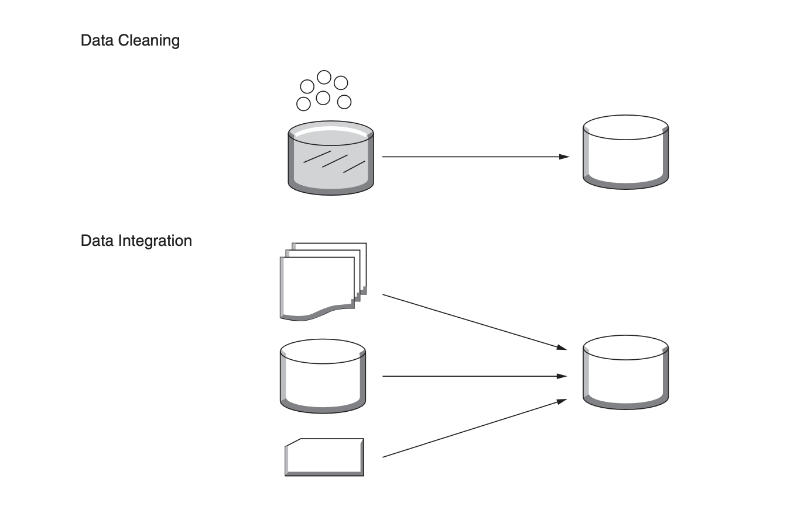

Slide 55
Methods: Data Reduction
Unit 1
Data reduction involves reducing the size of the dataset, either by selecting relevant features, aggregating data, or reducing the precision of the data. This is particularly useful when working with large datasets or when only a subset of the data is needed for analysis.
Key Techniques in Data Reduction:
Dimensionality Reduction: Reducing the number of features or columns while retaining most of the dataset's information. Techniques like Principal Component Analysis (PCA) or t-SNE are commonly used.
Data Aggregation: Grouping data into summary statistics (e.g., summing, averaging) to create a more compact representation of the data.
Feature Selection: Selecting only the most relevant features for analysis or modeling. Irrelevant or redundant features are discarded.
Data Compression: Lossless or Lossy

Slide 56
Methods: Data Reduction
Unit 1
How PCA Works?
1. Standardize the Data: Features are standardized (mean = 0, variance = 1) to ensure all dimensions are treated equally.
2. Compute Covariance Matrix: PCA analyzes the relationships between features by calculating the covariance matrix, which shows how features are correlated.
3. Find Principal Components:
Principal Components are new axes (directions) that maximize the variance/information in the data.
These are computed as eigenvectors of the covariance matrix, sorted by their corresponding eigenvalues (which represent the amount of variance explained).
4. Project Data onto New Axes: The data is transformed into the space defined by the top principal components. This results in a lower-dimensional representation of the data.

Slide 57
Methods: Data Reduction
Unit 1
import numpy as np
import pandas as pd
from sklearn.decomposition import PCA
from sklearn.preprocessing import StandardScaler
# Example dataset (10 samples, 5 features)
data = {
'Feature1': [1, 2, 3, 4, 5, 6, 7, 8, 9, 10],
'Feature2': [10, 9, 8, 7, 6, 5, 4, 3, 2, 1],
'Feature3': [2, 3, 4, 5, 6, 7, 8, 9, 10, 11],
'Feature4': [1, 1, 2, 2, 3, 3, 4, 4, 5, 5],
'Feature5': [5, 6, 7, 8, 9, 10, 11, 12, 13, 14]
}

Slide 58
Methods: Data Reduction
Unit 1
# Create a DataFrame
df = pd.DataFrame(data)
# Standardizing the data (PCA is sensitive to the scale of the data)
scaler = StandardScaler()
scaled_data = scaler.fit_transform(df)
# Apply PCA for dimensionality reduction (reduce to 2 principal components)
pca = PCA(n_components=2)
reduced_data = pca.fit_transform(scaled_data)
# Convert the reduced data to a DataFrame for easier viewing
reduced_df = pd.DataFrame(reduced_data, columns=['PC1', 'PC2'])
# Show the reduced data
print(reduced_df)

Slide 59
Methods: Data Reduction
Unit 1
Example:
# Dropping irrelevant columns
df.drop(columns=['employee_id'], inplace=True)
# Aggregating data to get the total purchase per customer
df_aggregated = df.groupby('customer_id')['purchase_history'].sum().reset_index()

Slide 60
Methods: Data Transformation
Unit 1
Data transformation is the process of converting data into a format suitable for analysis or modeling. This often involves normalizing, encoding, or creating new features from the original data.
Key Techniques in Data Transformation:
Normalization/Standardization: Scaling numerical values so they fall within a specific range (e.g., between 0 and 1) and standardization scales the data to have a mean of 0 and a standard deviation of 1. This is particularly important when working with machine learning algorithms like min max scaler, Neural networks and SVM, Logistic regression etc.
Feature Engineering: Creating new features from existing ones. For example, extracting the year, month, and day from a date column.
Categorical Encoding: Converting categorical variables into numerical representations. Techniques like One-Hot Encoding or Label Encoding are used to make categorical data suitable for machine learning.

Slide 61
Methods: Data Transformation Example
Unit 1
import numpy as np
import pandas as pd
from sklearn.preprocessing import MinMaxScaler, StandardScaler
# Test dataset
data = {'Student': ['A', 'B', 'C', 'D', 'E'], 'Score': [50, 80, 90, 60, 100]}
df = pd.DataFrame(data)
# Normalization
scaler = MinMaxScaler()
df['Normalized Score'] = scaler.fit_transform(df[['Score']])
# Standardization
scaler = StandardScaler()
df['Standardized Score'] = scaler.fit_transform(df[['Score']])
print(df)

Slide 62
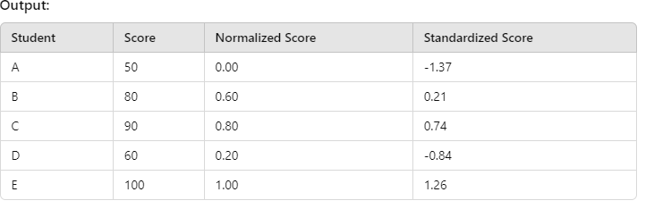
Methods: Data Transformation
Unit 1
Normalization is ideal when you need to fit values into a specific range.
Standardization is preferred when your data needs to have properties of a standard normal
distribution (mean = 0, std = 1). The choice between the two depends on the specific application
or algorithm requirements.

Slide 63
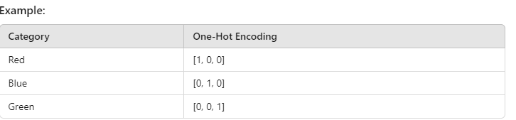
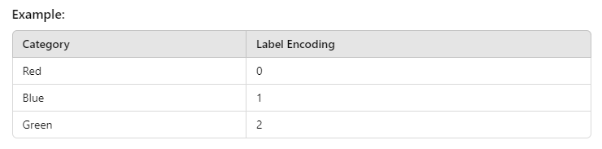
Methods: Data Transformation
Unit 1
Use One-Hot Encoding for nominal data without order (e.g., colors, cities). Each category is represented as a vector of zeros, with a single one indicating the presence of that category.
Use Label or Ordinal Encoding for ordered data (e.g., size: small, medium, large).

Slide 64
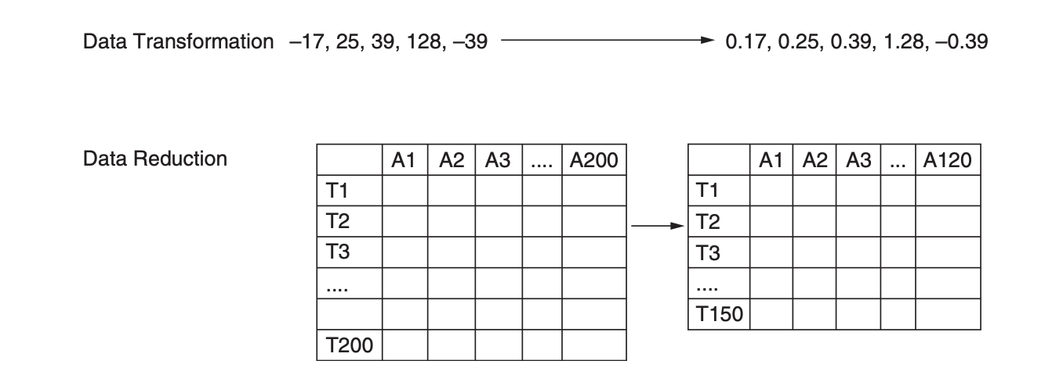

Slide 65
Methods: Data Discretization
Unit 1
Data discretization is the process of converting continuous data (i.e., numeric values) into discrete intervals or categories. This can be useful when you want to simplify the data for easier interpretation or when working with certain algorithms that require categorical data. Ex: Converting income values into income ranges like “Low,” “Medium,” and “High” instead of keeping each exact income value.
Key Techniques in Data Discretization:
Binning: Grouping continuous values into bins or ranges (e.g., age ranges like 20-30, 30-40).
Equal-Width Binning: Dividing the range of data into equal-width intervals.
Equal-Frequency Binning: Dividing the data into bins with an equal number of data points.
Custom Binning: Creating specific bins based on domain knowledge or business needs (e.g., income levels: Low, Medium, High).

Slide 66
Methods: Data Discretization
Unit 1
Equal Width Binning :
w= max-min/x
Data = [10,15,16,18,20,30,35,42,48,50,52,55]
(Intervals)X=3, w=(55-10)/3 = 15
[min, min+w-1] → [10, 24]
[min+w, min+2w-1] → [25, 39]
[min+2w, max] → [40,55]
1st – [10,15,16,18,20]
2nd –[30,35]
3rd – [42,48,50,52,55]

Slide 67
Methods: Data Discretization
Unit 1
Example:
import pandas as pd
# create a sample dataset
data = pd.DataFrame({'values': [1, 2, 3, 4, 5, 6, 7, 8, 9, 10]})
# bin the values into three intervals
data['bins'] = pd.cut(data['values'], bins=3, labels=['Low', 'Medium', 'High'])
# view the binned data
print(data)
# Binning numerical data into intervals
df['age_bin'] = pd.cut(df['age'], bins=[0, 18, 30, 40, 100], labels=['0-18', '19-30', '31-40', '41+'])
# Create age groups based on the binning
print(df[['age', 'age_bin']])

Slide 68
Methods: Data Discretization
Unit 1
Equal frequency Binning
f=n/x
Data = [10,15,16,18,20,30,35,42,48,50,52,55]
f = 12/3 = 4
1st → [10,15,16]
2nd → [18,20,30]
3rd → [35,42,48]
4th → [50,52,55]
# Perform equal-frequency binning using pandas qcut (quantile-based binning)
bins, bin_edges = pd.qcut(data_series, num_bins=3)

Slide 69
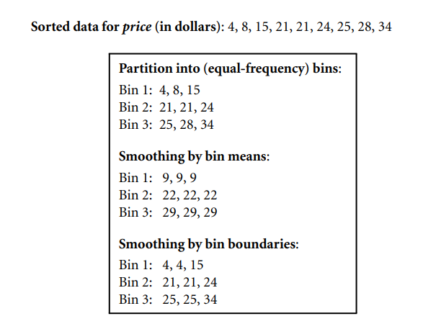
Methods: Data Discretization
Unit 1

Slide 70
Methods: Summary
Unit 1
Data Cleaning: Ensures the data is free from errors, missing values, or inconsistencies.
Data Integration: Combines multiple datasets or sources into a unified dataset.
Data Reduction: Reduces the size of the dataset by removing irrelevant data or summarizing the data.
Data Transformation: Converts data into a format that is suitable for analysis or modeling, such as scaling or encoding.
Data Discretization: Converts continuous data into discrete categories or intervals for easier analysis.
Each of these steps plays a critical role in transforming raw data into a clean, structured, and usable dataset, ultimately enabling more accurate analysis and model building.

Slide 71
University Questions
Unit 1
a)What is Data Science? Explain its use in AI. [5]
b) Explain the various applications of Data Science. [5]
c) Imagine you have given the data set with the Null or Nan values. Apply [5]
data wrangling methods used in data science.
a)What is data Wrangling? Explain various methods of data wrangling. [5]
b) Explain Data Cleaning, Data Transformation. [5]
c) Explain Data Integration and Discretization. [5]

Slide 72
Outlier Detection
Unit 1
The choice depends on the dataset's size, distribution, and the nature of the data.
For normally distributed data: Z-Score or IQR.
For skewed data: MAD or visual inspection.
For multidimensional data: Clustering or ML-based methods.

